Slide 1

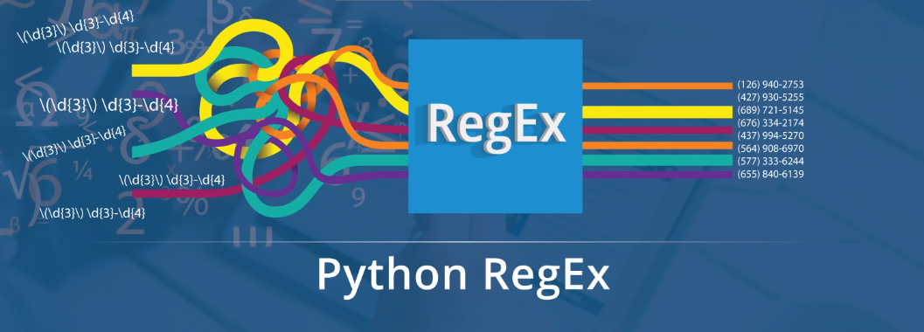
Let’s begin this Python RegEx by checking out why we need to make use of Regular Expressions.

Slide 2
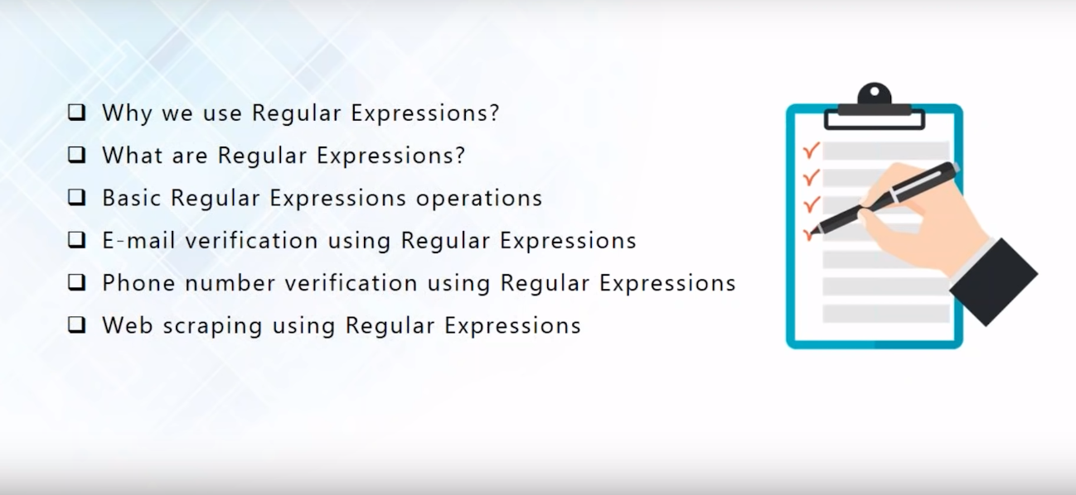
Agenda

Slide 3
Why we use Regular Expressions?

Slide 4
ANSWER
we will look at the various problems faced by us which in turn is solved by using Regular Expressions.

Slide 5
EXAMPLE. 1
You have a log file which contains a large sum of data. And from this log file, you wish to fetch only the date and time. As you can look at the image, readability of the log file is low upon first glance.
Regular Expressions can be used in this case to recognize the patterns and extract the required information easily.

Slide 6
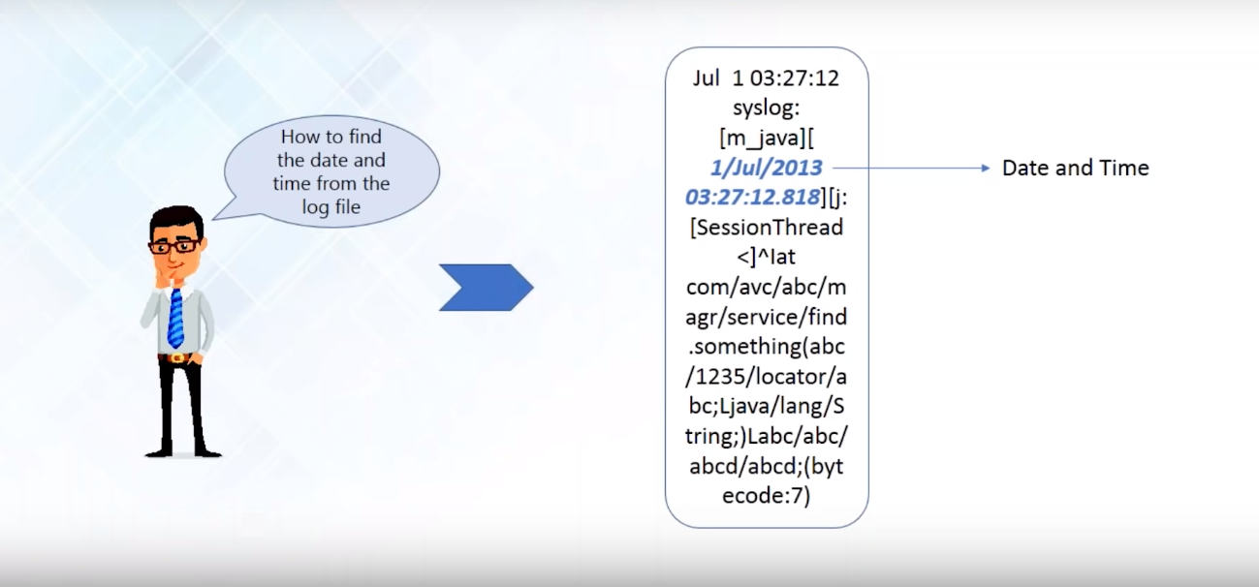
Why We Use Regular Expressions?

Slide 7
EXAMPLE. 2
You are a salesperson and you have a lot of email addresses and a lot of those addresses are fake/invalid. Check out the image below:
What you can do is, you can make use of Regular Expressions you can verify the format of the email addresses and filter out the fake IDs from the genuine ones.

Slide 8
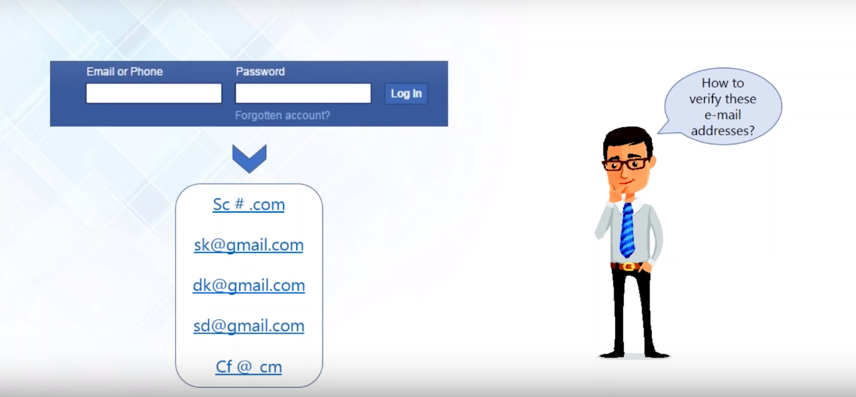
Why We Use Regular Expressions?

Slide 9
EXAMPLE. 3
It is pretty similar to the one with the salesperson example. Consider the following image:
How do we verify the phone number and then classify it based on the country of origin?
Every correct number will have a particular pattern which can be traced and followed through by using Regular Expressions.

Slide 10
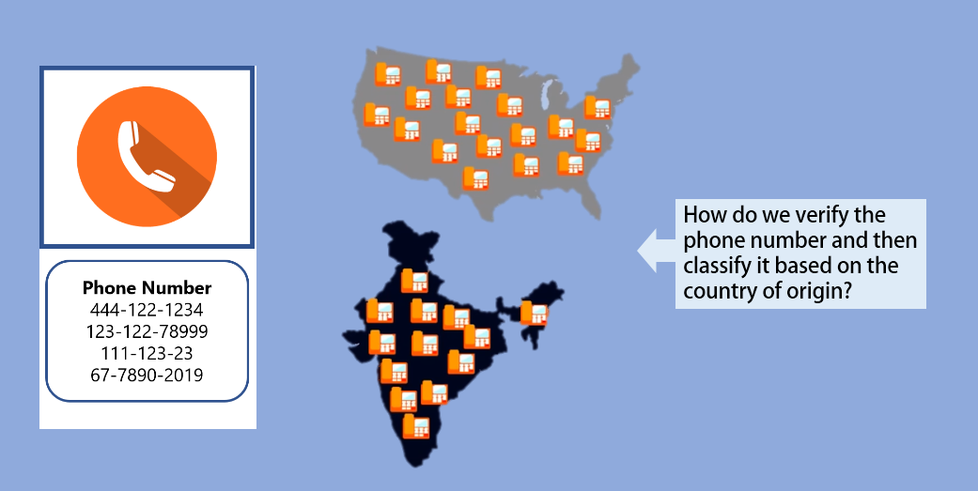
Why We Use Regular Expressions?

Slide 11

EXAMPLE. 4
We have a Student Database containing details such as name, age, and address. Consider the case where the Area code was originally 59006 but now has been changed to 59076. To manually update this for each student would be time-consuming and a very lengthy process.
Basically, to solve these using Regular Expressions, we first find a particular string from the student data containing the pin code and later replace all of them with the new ones.

Slide 12
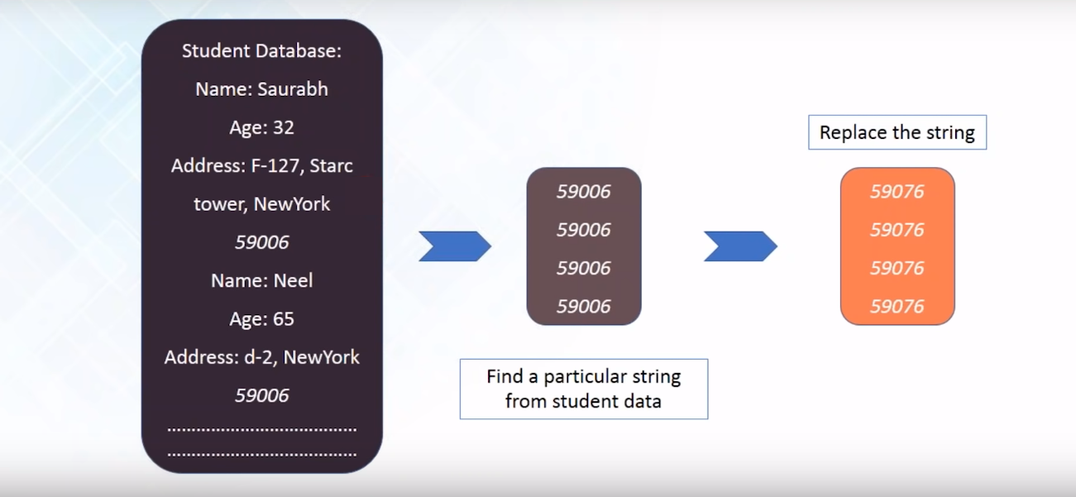
Why We Use Regular Expressions?

Slide 13
Regular Expressions can be used with multiple Languages
Java
Python
Ruby
Swift
Scala
Groovy
C#
PHP
Javascript

Slide 14
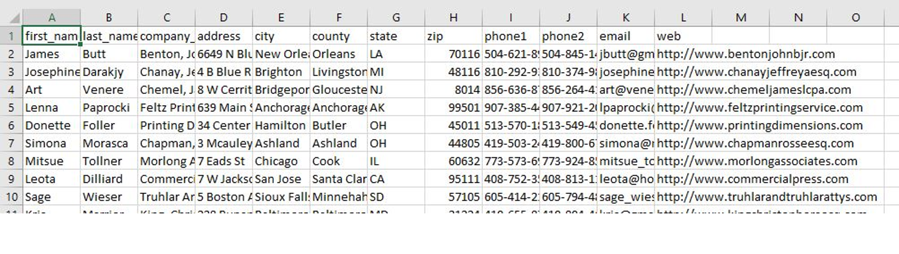
What are Regular Expressions?
A Regular Expression is used for identifying a search pattern in a text string. It also helps in finding out the correctness of the data and even operations such as finding, replacing and formatting the data is possible using Regular Expressions.
Example:

Slide 15
What are Regular Expressions?
Among all of the data from the given string, let us say we require only the City. This can be converted into a dictionary with just the name and the city in a formatted way. The question now is that, can we identify a pattern to guess the name and the city? Also, we can find out the age too. With age, it is easy, right? it is just an integer number.
How do we go about with the name? If you take a look at the pattern, all of the names start with an uppercase. With the help of the Regular expressions, we can identify both the name and the age using this method.

Slide 16
What are Regular Expressions?
import re
Nameage = '''
Janice is 22 and Theon is 33
Gabriel is 44 and Joey is 21
'''
ages = re.findall(r'd{1,3}', Nameage)
names = re.findall(r'[A-Z][a-z]*',Nameage)
ageDict = {}
x = 0
for eachname in names
ageDict[eachname] = ages[x]
x+=1
print(ageDict)

Slide 17
What are Regular Expressions?
There is no need to worry about the syntax at this point of time but since Python has amazing readability, you could very well guess what is happening the Regular Expression part of the code.
Output:
{'Janice': '22', 'Theon': '33', 'Gabriel': '44', 'Joey': '21'}
Let us check out all the operations we can perform using Regular Expressions.

Slide 18
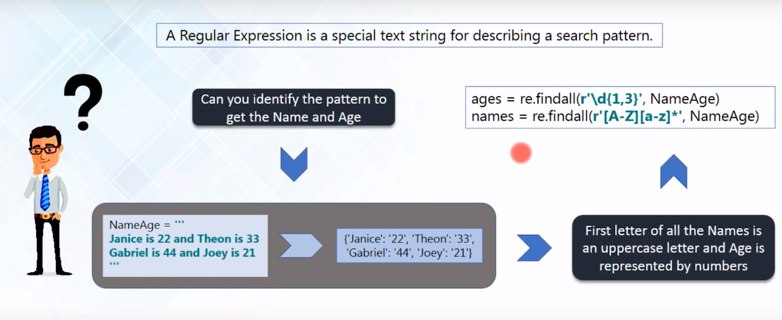
What are Regular Expressions?

Slide 19
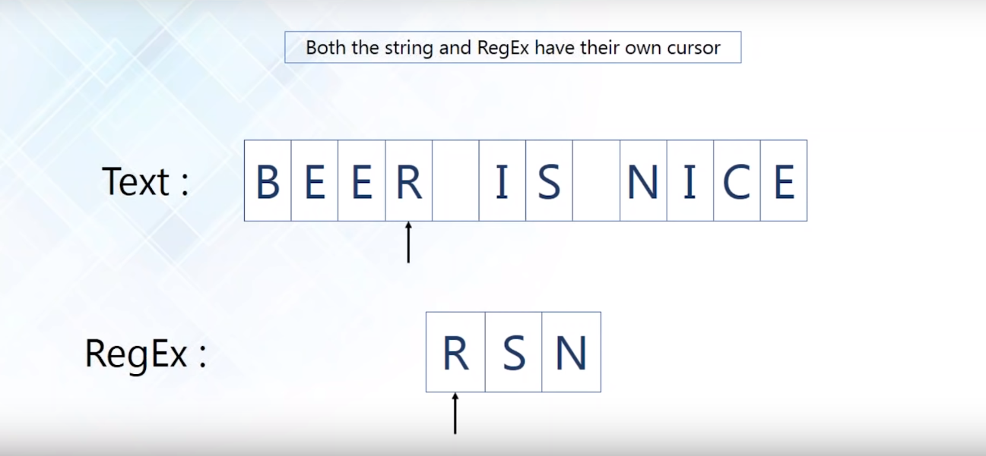
What are Regular Expressions?

Slide 20
Operations You Can Perform With Regular Expressions

Slide 21
Regular Expression Operations
Finding a word in the string
Generating an iterator
Matching words with patterns
Matching series of range of characters
Replacing a string
Matching a single character

Slide 22
Regular Expression Operations
Finding a word in the string
import re
allinform = re.findall("inform","We need to inform him with the latest information!")
for i in allinform:
print(i)

Slide 23
Regular Expression Operations
Finding a word in the string
Here, in this particular case inform will be found twice. One from the inform and the other from the information.
And it is as simple as this to find a word in a Regular Expression as shown above.
Next up on this Python RegEx blog, we will check out how we can generate an iterator using Regular Expressions

Slide 24
Regular Expression Operations
Generating an iterator
Generating an iterator is the simple process of finding out and reporting the starting and the ending index of the string.
For every match found, the starting and the ending index is printed. Can you take a guess of the output that we get when we execute the above program? Check it out below

Slide 25
Regular Expression Operations
Generating an iterator
import re
Str = "we need to inform him with the latest information"
for i in re.finditer("inform.", Str):
locTuple = i.span()
print(locTuple)

Slide 26
Regular Expression Operations
Output:
(11, 18) (38, 45)
Pretty simple, right?

Slide 27
Regular Expression Operations
Matching words with patterns
Consider an input string where you have to match certain words with the string. To elaborate, check out the following example code:
What is common in the string? You can see that the letters ‘a’ and ‘t’ are common among all of the input strings. [shmp] in the code denotes the starting letter of the words to be found. So any substring starting with the letters s, h, m or p will be considered for matching. Any among that and compulsorily followed by ‘at’ at the end.

Slide 28
Regular Expression Operations
Matching words with patterns
import re
Str = "Sat, hat, mat, pat"
allStr = re.findall("[shmp]at", Str)
for i in allStr:
print(i)

Slide 29
Regular Expression Operations
Output:
hat mat pat
Do note that they are all case sensitive. Regular expressions have amazing readability. Once you get to know the basics, you can start working on them in full swing and it’s pretty much easy, right?

Slide 30
Regular Expression Operations
Matching series of range of characters
We wish to output all the words whose first letter should start in between h and m and compulsorily followed by at. Checking out the following example we should realize the output we should get is hat and mat, correct?

Slide 31
Regular Expression Operations
Matching series of range of characters
import re
Str = "sat, hat, mat, pat"
someStr = re.findall("[h-m]at", Str)
for i in someStr:
print(i)

Slide 32
Regular Expression Operations
Output:
hat mat
Let us now change the above program very slightly to obtain a very different result. Check out the below code and try to catch the difference between the above one and the below one:

Slide 33
Regular Expression Operations
Matching series of range of characters
import re
Str = "sat, hat, mat, pat"
someStr = re.findall("[^h-m]at", Str)
for i in someStr:
print(i)

Slide 34
Regular Expression Operations
Found the subtle difference? We have added a caret symbol(^) in the Regular Expression. What this does it negates the effect of whatever it follows. Instead of giving us the output of everything starting with h to m, we will be presented with the output of everything apart from that.
The output we can expect is words which are NOT starting with letters in between h and m but still followed by at the last.
Output:
sat pat

Slide 35
Regular Expression Operations
Replacing a string
We can check out another operation using Regular Expressions where we replace an item of the string with something else. It is very simple and can be illustrated with the following piece of code:
In the above example, the word rat is replaced with the word food. The final output will look like this. The substitute method of the Regular Expressions is made use of this case and it has a vast variety of practical use cases as well.

Slide 36
Regular Expression Operations
Replacing a string
import re
Food = "hat rat mat pat"
regex = re.compile("[r]at")
Food = regex.sub("food", Food)
print(Food)

Slide 37
Regular Expression Operations
Output:
hat food mat pat

Slide 38
Regular Expression Operations
Matching a single character
A single character from a string can be individually matched using Regular Expressions easily. Check out the following code snippet:
import re
randstr = "12345"
print("Matches: ", len(re.findall("d{5}", randstr)))

Slide 39
Regular Expression Operations
The expected output is the 5th number that occurs in the given input string.
Output:
Matches: 1

Slide 40
Regular Expressions Aplications

Slide 41
Practical Use Cases Of Regular Expressions
We will be checking out 3 main use-cases which are widely used on a daily basis. Following are the concepts we will be checking out:
Phone Number Verification
E-mail Address Verification
Web Scrapping

Slide 42
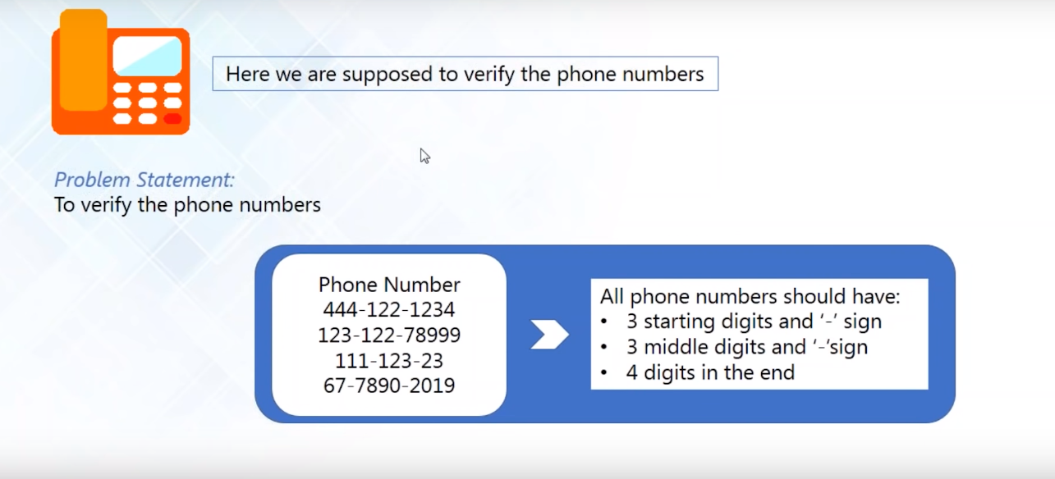
Phone Number Verification

Slide 43
Phone Number Verification
We will be using w in the example below. W=[a-zA-Z0-9_]
import re
phn = "412-555-1212"
if re.search("w{3}-w{3}-w{4}", phn):
print("Valid phone number")
Output:
Valid Phone Number

Slide 44
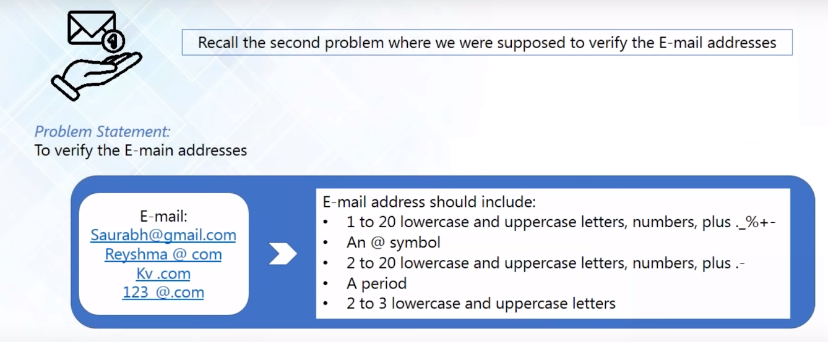
E-mail Address Verification

Slide 45
E-mail Address Verification
Manually, it just takes you one good glance to identify the valid mail IDs from the invalid ones. But how is the case when it comes to having our program do this for us? It is pretty simple considering the following guidelines are followed for this use-case.
import re
email = "ac@aol.com md@.com @seo.com dc@.com"
print("Email Matches: ", len(re.findall("[w._%+-]{1,20}@[w.-]{2,20}.[A-Za-z]{2,3}", email)))

Slide 46
E-mail Address Verification
Output:
Email Matches: 1
As you can check out from the above output, we have one valid mail among the 4 emails which are the inputs.
This basically proves how simple and efficient it is to work with Regular Expressions and make use of them practically.

Slide 47
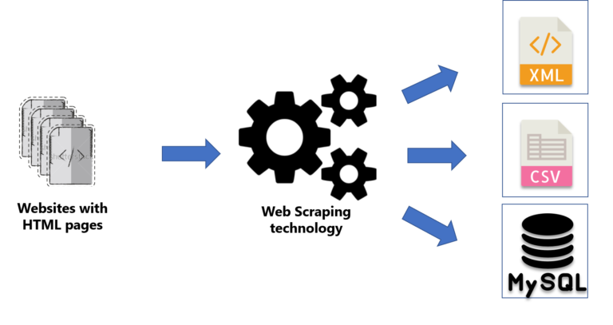
Web Scrapping
Scrapping all of the phone numbers from a website for a requirement.
To understand web scraping, check out the following diagram:

Slide 48
Web Scrapping
We already know that a single website will consist of multiple web pages. And let us say we need to scrape some information from these pages.
Web scraping is basically used to extract the information from the website. You can save the extracted information in the form of XML, CSV or even a MySQL database. This is achieved easily by making use of Python Regular Expressions.

Slide 49
Web Scrapping
import urllib.request
from re import findall
url = "http://www.summet.com/dmsi/html/codesamples/addresses.html"
response = urllib.request.urlopen(url)
html = response.read()
htmlStr = html.decode()
pdata = findall("(d{3}) d{3}-d{4}", htmlStr)
for item in pdata:
print(item)

Slide 50
Web Scrapping
Output:
(257) 563-7401
(372) 587-2335
(786) 713-8616
(793) 151-6230
(492) 709-6392
(654) 393-5734
(404) 960-3807
(314) 244-6306
(947) 278-5929
(684) 579-1879
(389) 737-2852
(660) 663-4518
(608) 265-2215
(959) 119-8364
(468) 353-2641
(248) 675-4007
(939) 353-1107
(570) 873-7090
(302) 259-2375
(717) 450-4729
(453) 391-4650
(559) 104-5475
(387) 142-9434
(516) 745-4496
(326) 677-3419
(746) 679-2470
(455) 430-0989
(490) 936-4694
(985) 834-8285
(662) 661-1446
(802) 668-8240
(477) 768-9247
(791) 239-9057
(832) 109-0213
(837) 196-3274
(268) 442-2428
(850) 676-5117
(861) 546-5032
(176) 805-4108
(715) 912-6931
(993) 554-0563
(357) 616-5411
(121) 347-0086
(304) 506-6314
(425) 288-2332
(145) 987-4962
(187) 582-9707
(750) 558-3965
(492) 467-3131
(774) 914-2510
(888) 106-8550
(539) 567-3573
(693) 337-2849
(545) 604-9386
(221) 156-5026
(414) 876-0865
(932) 726-8645
(726) 710-9826
(622) 594-1662
(948) 600-8503
(605) 900-7508
(716) 977-5775
(368) 239-8275
(725) 342-0650
(711) 993-5187
(882) 399-5084
(287) 755-9948
(659) 551-3389
(275) 730-6868
(725) 757-4047
(314) 882-1496
(639) 360-7590
(168) 222-1592
(896) 303-1164
(203) 982-6130
(906) 217-1470
(614) 514-1269
(763) 409-5446
(836) 292-5324
(926) 709-3295
(963) 356-9268
(736) 522-8584
(410) 483-0352
(252) 204-1434
(874) 886-4174
(581) 379-7573
(983) 632-8597
(295) 983-3476
(873) 392-8802
(360) 669-3923

Slide 51
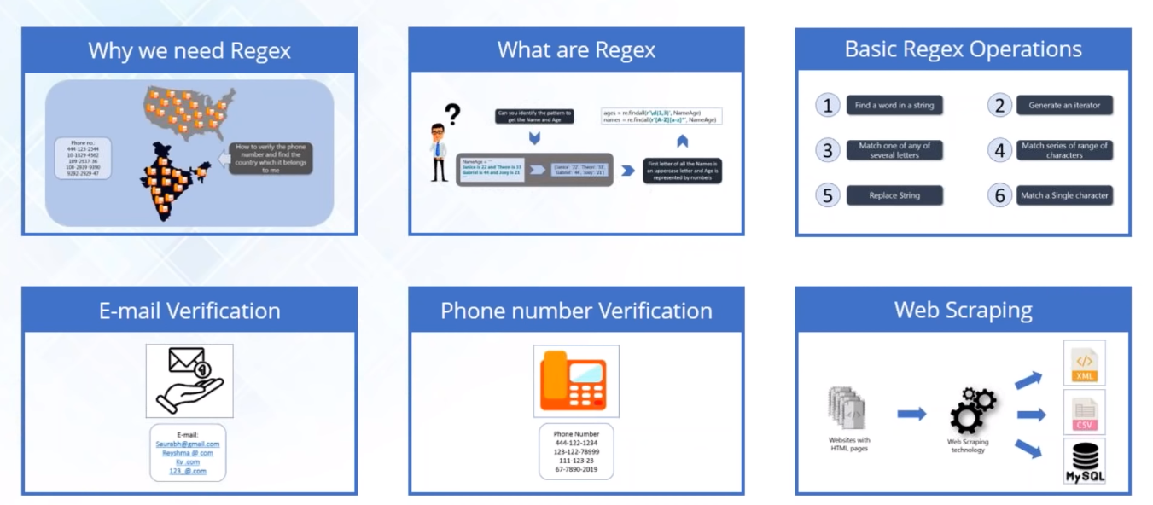
Brief Summary

Slide 52
THANK YOU

